Slide 1
Regular Grammars

Slide 2
Grammars
A grammar is a way of describing languages
A regular grammar describes a regular language
→ Regular Grammar (left-linear or right-linear)
→ Linear grammars (left-linear or right-linear or left-right linear )

Slide 3
Linear grammar
A linear grammar is a context-free grammar that has at most one non-terminal symbol on the right hand side of each grammar rule.
A rule may have just terminal symbols on the right hand side (zero non-terminals).
Here is a linear grammar:
S → aA
A → aB
B → Bb

Slide 4
Regular Grammar
A grammar G=( V, T, S, P) is right-linear if the productions are of form
A→xB or A→ x, where A, B∈V, x∈T*.
A grammar G=( V, T, S, P) is left-linear if the productions are of form
A→Bx or A→ x, where A, B∈V, x∈T*.

Slide 5




Slide 6



Slide 7
Examples
right-linear
G₁=({S}, {a,b}, S, {S→abS|a})
left-linear
G₂=({S, S₁, S₂}, {a, b}, S,
{S→S₁ab, S₁→S₁ab|S₂, S₂→a})
Not Regular: G₃=({S, A, B}, {a,b}, S,
{S→A, A→aB|λ, B→Ab})

Slide 8







Slide 9



Not a Regular Grammar

Slide 10














Slide 11





Slide 12
Left linear grammars are evil
Consider this rule from a left linear grammar: A → Babc
Can that rule be used to recognize this string: abbabc
We need to check the rule for B: B → Cb | D
Now we need to check the rules for C and D.
This is very complicated.
Left linear grammars require complex parsers.

Slide 13
Right linear grammars are good
Consider this rule from a right linear grammar: A → abcB
Can that rule be used to recognize this string: abcabb
We immediately see that the first part of the string – abc – matches the first part of the rule. Thus, the problem simplifies to this: can the rule for B be used to recognize this string : abb
Parsers for right linear grammars are much simpler.

Slide 14
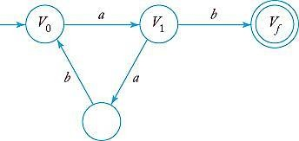
Right-linear grammars
➔ Regular languages
Variables are depicted as states.
Productions are transferred into transitions.
Example, P={V₀→aV₁, V₁→abV₀|b}

Slide 15
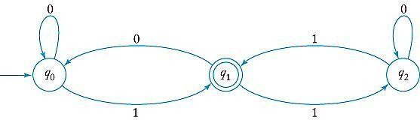
Regular languages (dfa’s)
➔right-linear grammars
States q₀, q_{1,} … are depicted as variables V₀, V₁.
δ(q_{i}, a)=q_{j} is denoted as V_{i}→ aV_{j}
Add V_{f} →λ (final state)
Example
q0 -> 0q0, q0->1q1, q1->0q0, q1 -> 1q2, q2 -> 1q1, q2 -> 0q2 , q1 -> λ
Identify the language generated by this grammar…..

Slide 16


Example : Construct an automata for a given grammar

Slide 17







Slide 18


Slide 19



Slide 20







Slide 21


Slide 22
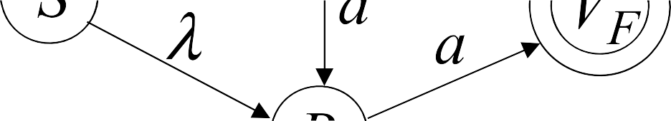


Slide 23


Slide 24
















Slide 25









From Left linear grammar G

Slide 26







Slide 27
Conversion of Left Linear Grammar(LLG) to Finite Automata
Converting left linear grammar to Finite Automata is simple. Follow the steps:
Take reverse of LLG
Create Finite automata
Then again take reverse of the FA and that will be our final output
Start State: It will be the first production's state
Final State: Take those states which end up with input alphabets. eg. State A and C are in below LLG

Slide 28
Here we are giving one Left Linear Grammar(LLG)
A -> Ba/Ab/b
B -> Ca/Bb
C -> Aa/Cb/a
1.Take the reverse of the LLG
A -> aB/bA/b
B -> aC/bB
C -> aA/bC/a

Slide 29
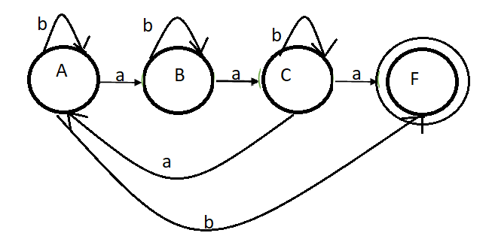
2. Now create the FA

Slide 30
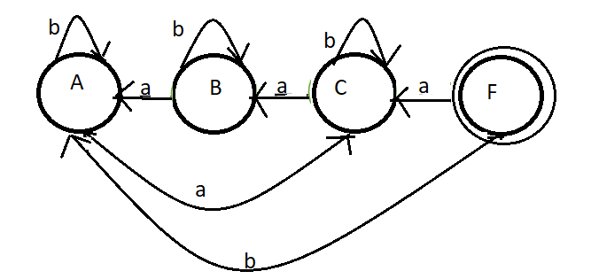
3. Now take reverse of the above FA (this is final output)

Slide 31
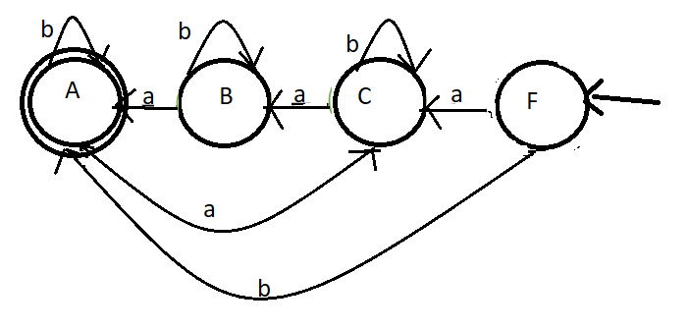
Convert final to start and start to final

Slide 32
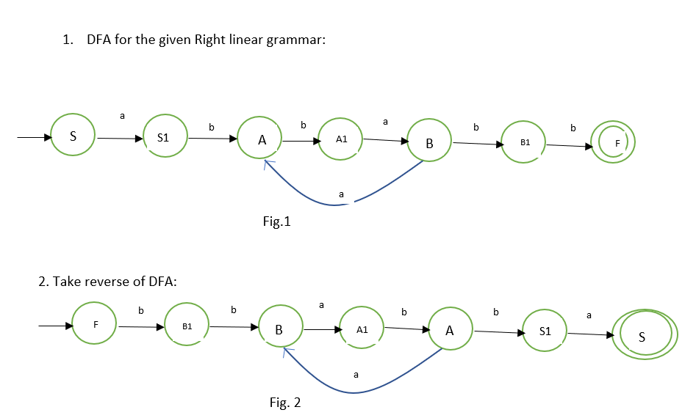
Convert the following Right Linear grammar (RL) to Left linear grammar (LL):
S -> abA
A -> baB
B -> aA| bb

Slide 33
Fig.2 equivalent Grammar:
F -> bB1
B1 -> bB
B -> aA1
A1 ->bA
A -> aB
A -> bS1
S1 -> aSf
Sf -> λ
Reverse it to make left linear:
F -> B1b
B1 -> Bb
B -> A1a
A1 -> Ab
A ->Ba
A -> S1b
S1 -> Sf a
Sf -> λ
Simplified Left linear:
F -> Bbb
B -> Aba
A -> Ba | ab

Slide 34
Thank you

